Slide 1

Principles and Perspectives on Funding for Outcomes
Missouri General Assembly’s Joint Committee on Education
January 24, 2013

Slide 2
Complete college America
Founded in 2009 with a single focus on working with states to:
  Significantly increase the number of students successfully earning degrees and credentials of value in the labor market, and
  Close attainment gaps for traditionally underrepresented populations.
CCA’s work is accomplished by providing technical assistance to Alliance States and other states committed to developing and implementing high-impact, large-scale, completion-focused strategies.

Slide 3
Alliance of States
Commitment to State and Campus Goals
Commitment to Measuring Progress and Success via Common Completion Metrics
Commitment to Bold Action: High-Impact, Large-Scale Strategies

Slide 4

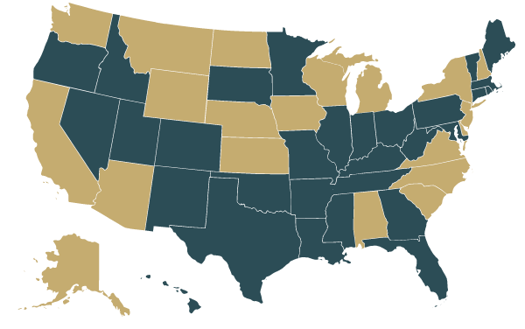
Arkansas
Colorado
Connecticut
District of
Columbia
Florida
Georgia
Hawaii
Idaho
Illinois
Indiana
Kentucky
Louisiana
Maine
Maryland
Massachusetts
Minnesota
Mississippi
Missouri
Nevada
New Mexico
Ohio
Oklahoma
Oregon
Pennsylvania
Rhode Island
South Dakota
Tennessee
Texas
Utah
Vermont
West Virginia
Wisconsin
Wyoming
33 Member States
Alliance State

Slide 5
CCA Modus Operandi
National Convening
Completion Academies
Institutes
In-State Completion Academies
Completion Innovation Challenge Grant
Publications
In-State Technical Assistance

Slide 6
Missouri and the CCA Alliance
Missouri joined the CCA Alliance in 2011
MO team has attended two national convenings
MO team participated in the fall 2011 completion academy
MO team attended the Gateway Course Success Institute in spring 2013
Very active participant in completion metrics collection and reporting

Slide 7
Core Strategies to
Increase College Completion:
Conditions for Change
  Collect and report common college completion metrics
  Fund results
Game Changers
  Transform remediation
  Accelerate success
  Restructure delivery
  Assess and count certificates
  Place students on guided pathways early
None of these strategies is a silver bullet; they should be deployed together.

Slide 8
Outcome Funding Nationally
AASCU’s number one higher education state policy issue for 2013: Boosting Institutional Performance
  “This year’s legislative sessions will pick up where last year’s left off, with ongoing momentum for developing and implementing state performance-based higher education funding systems. These funding formulas dominate the current higher education policy landscape – 33 states have expressed interest or are currently implementing performance-based funding systems, up from fewer than 10 states just two years ago.”
Source: American Association of State Colleges and Universities, Higher Education Policy Brief, January 2013

Slide 9
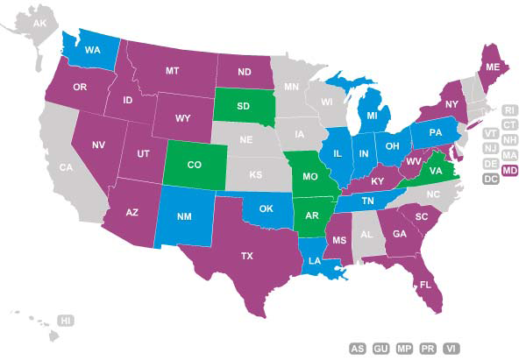
Outcome Funding Nationally
Performance funding in
place
Transitioning to
performance funding
Formal discussions on
performance funding
No formal activity
Source: National Conference on State Legislatures

Slide 10
Outcome Funding
Why?
  To improve institutional performance with respect to state goals (and institutional goals) by linking state funding for institutions to achievement of those goals
How?
  Increasing institutional awareness of state priorities
  Increasing awareness of institutional performance
  Encouraging organizational changes (e.g., programs and curricula, student services delivery, administrative efficiencies) that improve performance

Slide 11
The Reinvention of Performance Funding
Performance funding 1.0 models provided bonuses/add-ons
Performance funding 1.0 models provided small amounts of funding
Performance funding 1.0 tended to disappear when funding became scarce
Data systems weren’t as fully developed

Slide 12
Smart System Design
All funding models are performance based – there are some state objectives behind them
  Models have typically rewarded enrollment
Educational outcomes – degrees and high-value certificates – are now the predominant objective
Reward the new set of goals without diminishing or creating adverse consequences for other important goals
Don’t reward performance as an add-on
Fund access, progress, and success.

Slide 13
Get Agreement on Goals
Establish a Public Agenda first that lays out a limited set of goals
  Process matters
  Goals should be tailored to the state
  The focus should be on the state and citizens, not on the institutions of higher education
Examples:
  Texas – Closing the Gaps
  Tennessee – Complete College Tennessee
  Illinois – Public Agenda for College and Career Success
  Indiana – Reaching Higher, Achieving More
  Oklahoma – Reach Higher (Brain Gain)
  Georgia – Complete College Georgia

Slide 14
Construct Performance Metrics Broadly
Increase the number of degrees and certificates awarded
Include innovations that expand and broaden the state’s economy
  IN, IL and TN research expenditures
May focus on production of STEM degrees, health care degrees, or other state priorities
  OH universities, LA, PA universities option
Develop a workforce for high-need occupations
  TN and WA community colleges
All institutions should have a chance to benefit from achieving excellence and meeting state goals

Slide 15
Limit Outcomes Rewarded
But not too broadly
Avoid “kitchen sink” models
  South Carolina early formula
    E.g., faculty credentials, salaries, mission statements
Institutions will press for factors that benefit them – limit institution specific measures (PA)
Factors accrete to the formula over time
Focus institutional attention on key state priorities
States that can’t limit priorities send mixed messages and dilute their efforts

Slide 16
Promote Mission Differentiation
Research universities
  Course completions (OH)
  Doctoral and professional degrees (TN, OH)
  External research funding (IN, TN, IL)
Comprehensive universities
  Course completions (OH, IN)
  Bachelor’s and Master’s degrees (OH, TN)
Community Colleges
  Momentum points (WA, OH, IL, IN)
  Workforce training (TN, LA, WA)
  Basic skills (WA)
  Dual credit enrollment (IN, TN)

Slide 17
Reward Success with Underserved Populations
Don’t lose sight of access, but don’t settle for enrollment
Avoid cherry picking students
Give extra weight to students from at-risk populations:
  Low income – usually Pell or state-aid eligible (TN, OH, TX, IL, IN, PA)
  Adults (TN, WV, TX, IL)
  Academically at risk (TX)
  Traditionally underrepresented (IL)
  Part-time students (IL)

Slide 18
Reward Progress
Improvements in degree and certificate production don’t happen immediately
Reward institutions that help students make step-by-step progress:
  Credit hour completion: 24, 48, 72 (TN)
  Value upper-level credits at a higher rate (OH)
  Reward institutions for students achieving “momentum points” (WA, OH)
    Complete remedial courses
    Succeed in first college-level course
    Complete 15, 30 credit hours

Slide 19
Make Metrics Difficult to Game
Keep formulas simple and transparent
Use numbers, not rates
Test the metrics:
  What is the easiest way to win?
  Is that behavior the intended behavior?

Slide 20
Reward Continuous Improvement
Don’t shoot for predetermined levels of performance
Do start from current institutional performance levels and allocate funds on the basis of year-over-year improvement

Slide 21
Make the Pool of Funds Matter
Small proportions of funds don’t elicit improvement
An art, not a science
  Tennessee: 100%
  Ohio: 100% for universities, 100% for CCs by FY15
  Colorado, Louisiana, and Arkansas legislation: 25%
  Pennsylvania universities (PASSHE): 2.4% of education and general funds (equals 8% of state appropriations)
  Indiana: 5 – 6%, goal is 7%
  Illinois: < 1% to begin with amount growing
  Georgia: revenue neutral base FY15, all new funds thereafter
  South Dakota: $3 M new funds matched by $3 M base

Slide 22
Align All Parts of the Model with State Goals
In enrollment-driven models, base calculations on completed credits, not enrolled credits (OH)
In base-plus models, freeze the base and devote all new funds to the performance pool (MI, KY)
Make the performance pool an increasingly large share of the state allocation (IL, AR)

Slide 23
Implement Wisely
Don’t wait for new money (but starting with it, if available, is fine)
Do include a phase-in provision
Employ stop-loss, not hold-harmless provisions
Continue performance funding in good times and bad: funds that address the issues identified as being the most important should be the last dollars cut

Slide 24
The JCE Model: You May Want to Consider . . .
Elaborating state goals more clearly: What matters most to the state?
Giving extra weight to low-income students, part- time students, or adult students in the formula to mitigate risks of using rates.
Differentiating levels of state support. The funding model shouldn’t assume 35% state support across all sectors; should move to state share of total operating expenditures by sector.

Slide 25
The JCE Model: You May Want to Consider . . .
Adjusting the stop-loss percentage. 95% stop-loss may affect institutional stability too much, too fast – perhaps 98% to start.
Starting with a smaller proportion of the base. Ten percent of the base distributed by performance factors may be too much, too fast – perhaps 5% to start and increasing in 5% increments to desired proportion.

Slide 26
Use All the Tools in the Toolbox
Funding for results is only one tool in the toolbox
State policymakers have a pivotal role in creating a more educated workforce, and they should move on multiple fronts:
Use common college completion metrics
Transform remediation
Accelerate success
Restructure delivery
Assess and count certificates
Place students on guided pathways early

Slide 27
Mike Baumgartner, Ph. D.
mbaumgartner@completecollege.org
www.completecollege.org
202-618-4325

